Slide 1
Library Management System
LMS
Made by: Zoltán András Tóth, Máté Vágvölgyi, Soma István Zsömbörgi

Slide 2
The problem
The solution
We heard librarians say they are dissatisfied with the current system.
It was also inconvenient for us, students.
We decided to create our own program to replace the obsolete software with managing books, users and all the borrowings.

Slide 3






Teamwork
Applications:
GitHub
Discord
Figma
Allocation of tasks:
Frontend: Zoltán Tóth
Backend: Soma Zsömbörgi
Desktop Application: Máté Vágvölgyi

Slide 4
Base idea
Frontend
Backend
LMS Desktop
Website for members
Register to reserve
Verify email address
Connection between Frontend and Database
Software for admins and librarians
Application for managing a physical library

Slide 5
Database - MySQL
Function1
Function2

Slide 6
Functions of the Website - Frontend
Function1
Function2

Slide 7
Functions of the Website - Backend
Function1
Function2

Slide 8
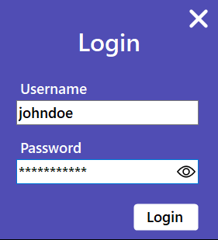
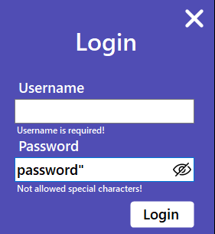
Functions of LMS Desktop
Login
Admin or Librarian
Show password
Real time error feedback

Slide 9
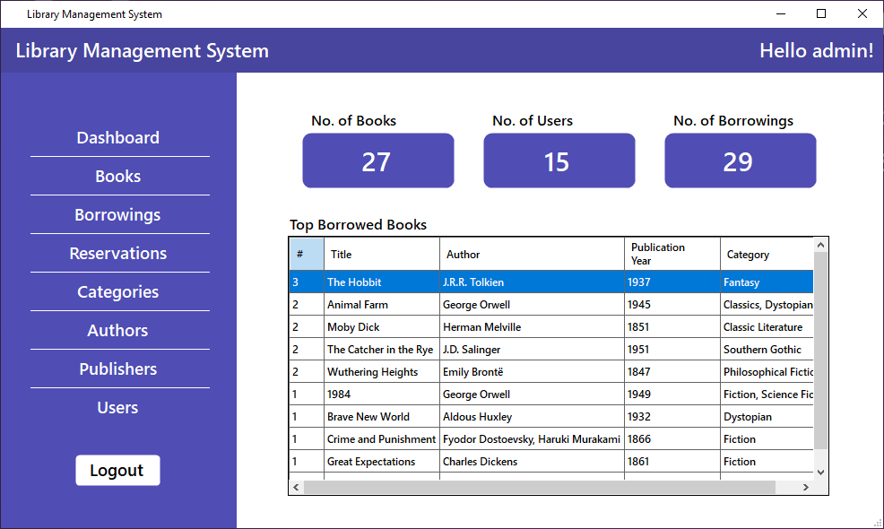
Functions of LMS Desktop
Login
Admin or Librarian
Show password
Real time error feedback

Slide 10
Functions of LMS Desktop
Books, user and borrowing statistics
Manage database through the app
Change personal data

Slide 11
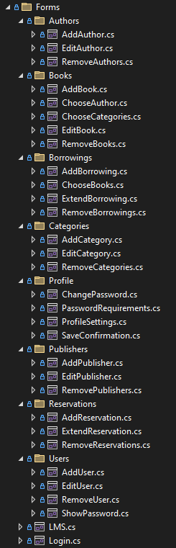
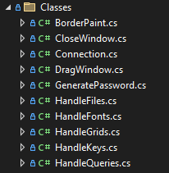
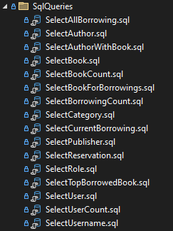
What did we use?
Windows Forms – C#
.NET Framework 4.8.1
Nugget Packages: - MySQL - BCrypt
HTTP Client
Regular Expressions
OnceClick
Inno Setup Compiler

Slide 12
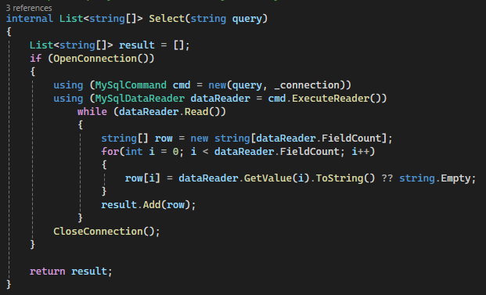
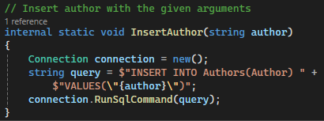
MySQL connection in C#
Reusable Select function
Straightforward function names

Slide 13
Future improvements
Separate mobile application
Overdue fees -> Online payment
Changeable languages
Customizable themes

Slide 14
Sources
Presentation template
All source for the pictures are linked to them

Slide 15
Library Management System
LMS
Made by: Zoltán András Tóth, Máté Vágvölgyi, Soma István Zsömbörgi

